Slide 1

NodeJS
Amarjeet Singh

Slide 2
Agenda
Node.JS

Slide 3

The Server-side JavaScript

Slide 4
What to expect ahead….
Introduction
Some (Confusing) Theory
Examples
A couple of weird diagrams
Pics showing unbelievable benchmarks
Use Cases

Slide 5
What is NodeJS ?
V8 is an open source JavaScript engine developed by Google. Its written in C++ and is used in Google Chrome Browser.
Node.js runs on V8.
It was created by Ryan Dahl in 2009.
Latest version is 4.1.0
Is Open Source. It runs well on Linux systems, can also run on Windows systems.
It provided an event driven architecture and a non blocking
I/O that optimize and scalability. These technology uses for real time application.
It used Google JavaScript V8 Engine to Execute Code.
It is used by Groupon, SAP , LinkedIn ,Microsoft,Yahoo ,Walmart ,Paypal.

Slide 6
Introduction: Basic
In simple words Node.js is ‘server-side JavaScript’.
In not-so-simple words Node.js is a high-performance network applications framework, well optimized for high concurrent environments.
It’s a command line tool.
In ‘Node.js’ , ‘.js’ doesn’t mean that its solely written JavaScript. It is 40% JS and 60% C++.
From the official site:
‘Node's goal is to provide an easy way to build scalable network programs’ - (from nodejs.org!)

Slide 7
JavaScript V8 Engine
The V8 JavaScript Engine is an open source JavaScript engine developed by Google for the Google Chrome web browser.
V8 compiles JavaScript to native machine code
The V8 engine is extremely fast.
V8 is focused on the web, so it is proficient at things like Hypertext Transfer Protocol (HTTP), Domain Name System (DNS), and Transmission Control Protocol (TCP).

Slide 8
Introduction: Advanced (& Confusing)
Node.js uses an event-driven, non-blocking I/O model, which makes it lightweight. (from nodejs.org!)
It makes use of event-loops via JavaScript’s callback functionality to implement the non-blocking I/O.
Programs for Node.js are written in JavaScript but not in the same JavaScript we are use to. There is no DOM implementation provided by Node.js, i.e. you can not do this:
var element = document.getElementById(“elementId”);
Everything inside Node.js runs in a single-thread.

Slide 9
Features of Node.js
Asynchronous and Event Driven All APIs of Node.js library are asynchronous that is non-blocking. It essentially means a Node.js based server never waits for a API to return data. Server moves to next API after calling it and a notification mechanism of Events of Node.js helps server to get response from the previous API call.
Very Fast Being built on Google Chrome's V8 JavaScript Engine, Node.js library is very fast in code execution.

Slide 10
Single Threaded but highly Scalable - Node.js uses a single threaded model with event looping. Event mechanism helps server to respond in a non-blocking ways and makes server highly scalable as opposed to traditional servers which create limited threads to handle requests. Node.js uses a single threaded program and same program can services much larger number of requests than traditional server like Apache HTTP Server.
No Buffering - Node.js applications never buffer any data. These applications simply output the data in chunks.

Slide 11
What can you do with Node.js ?
You can create an HTTP server and print ‘hello world’ on the browser in just 4 lines of JavaScript. (Example included)
You can create a TCP server similar to HTTP server, in just 4 lines of JavaScript. (Example included)
You can create a DNS server.
You can create a Static File Server.
You can create a Web Chat Application like GTalk in the browser.
Node.js can also be used for creating online games, collaboration tools or anything which sends updates to the user in real-time.

Slide 12
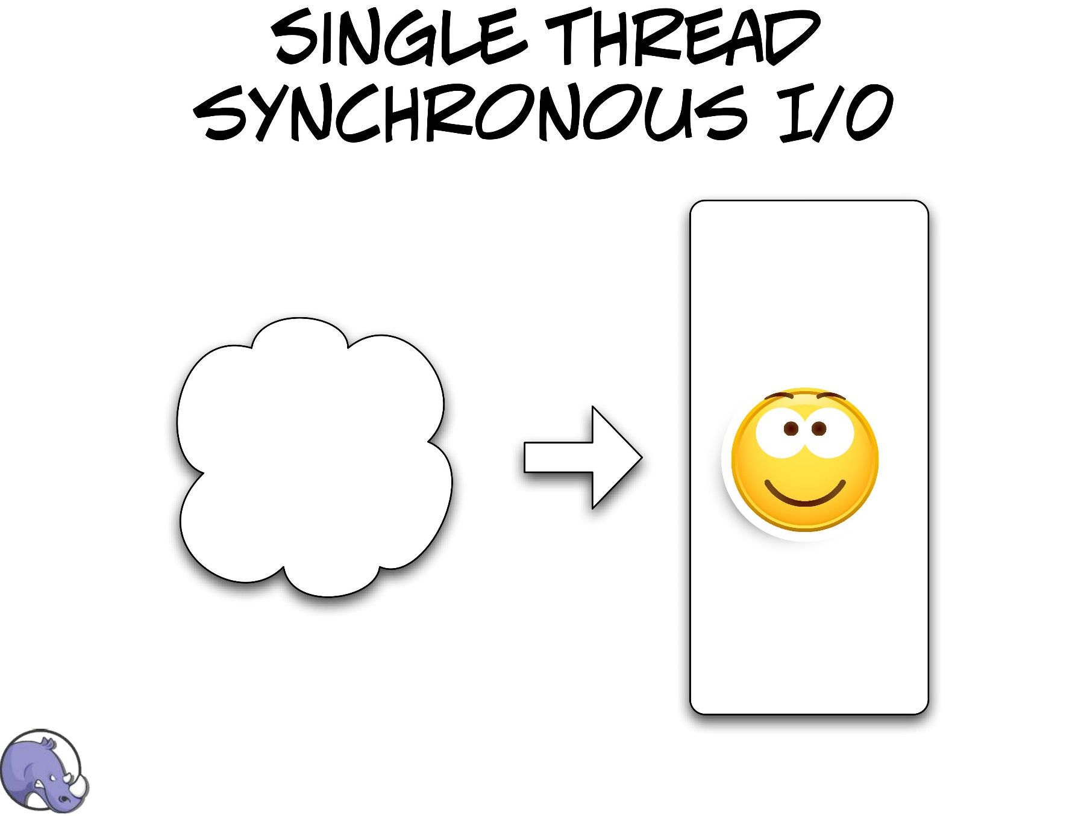

Slide 13
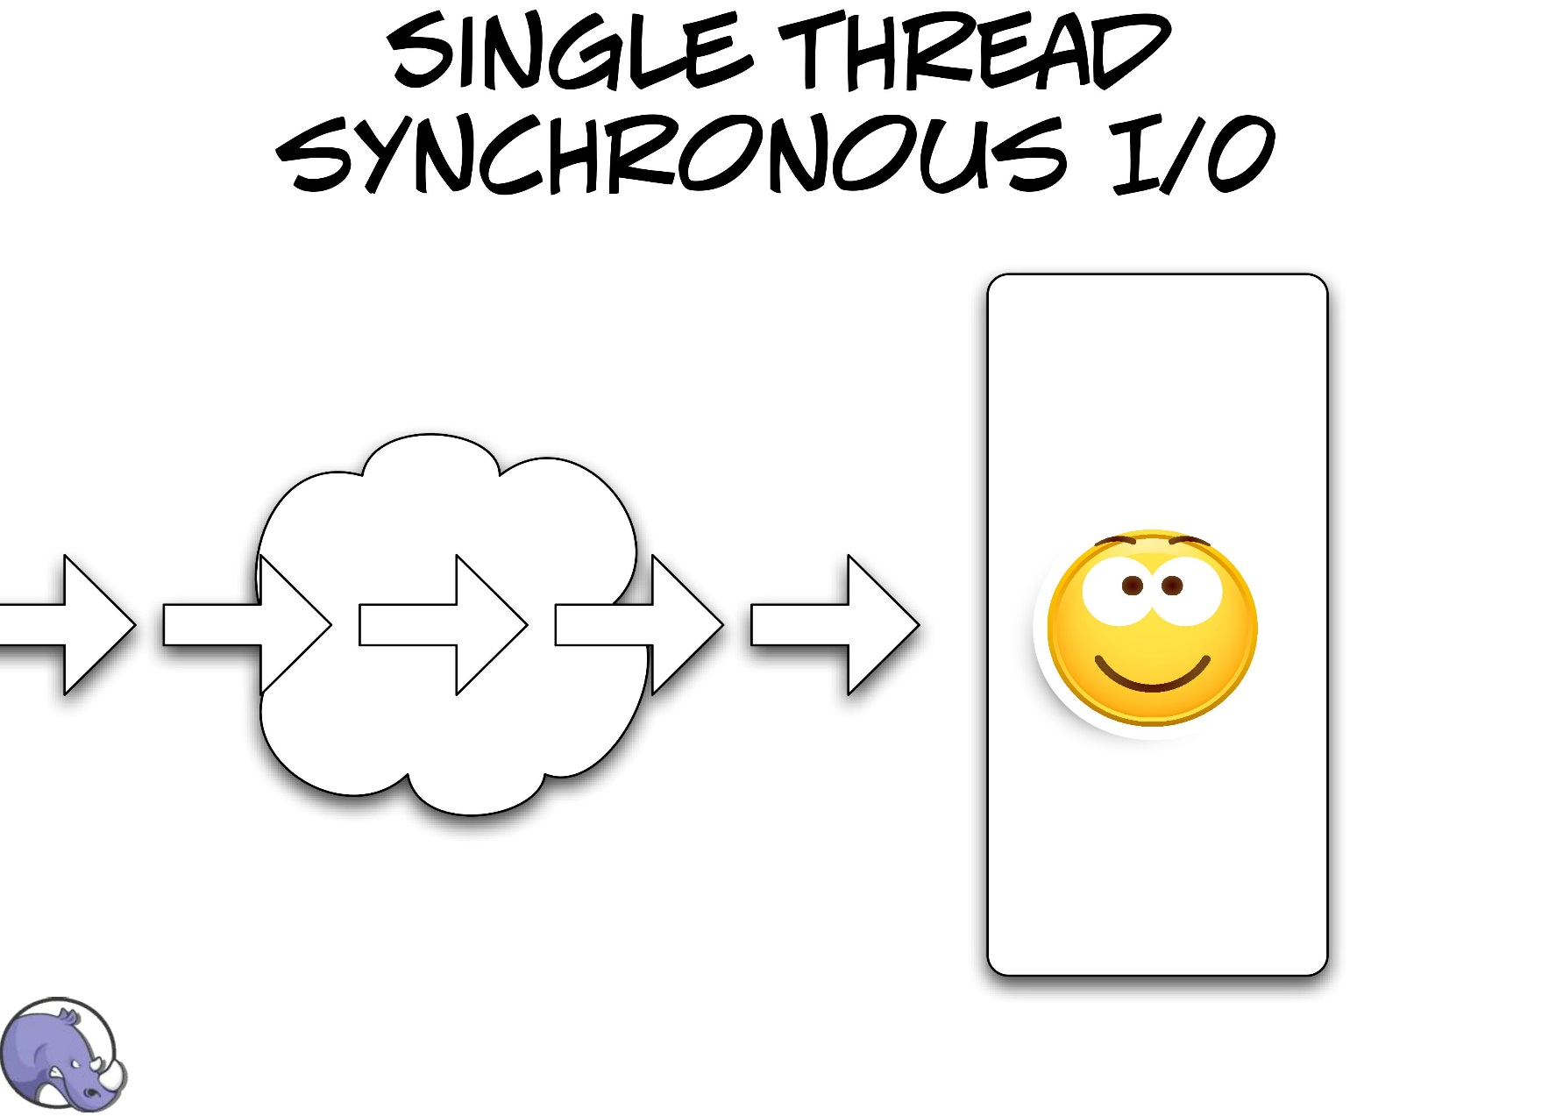

Slide 14
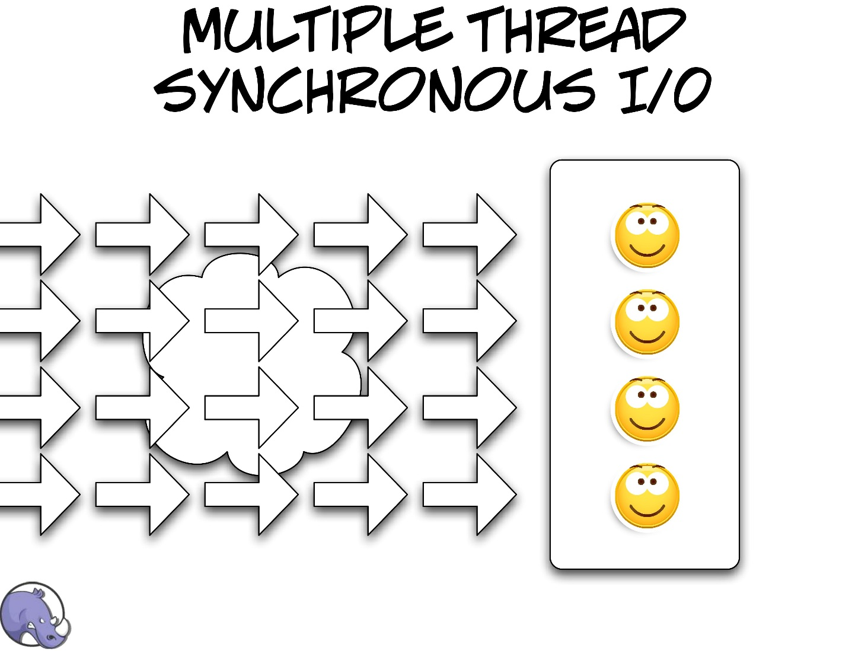

Slide 15
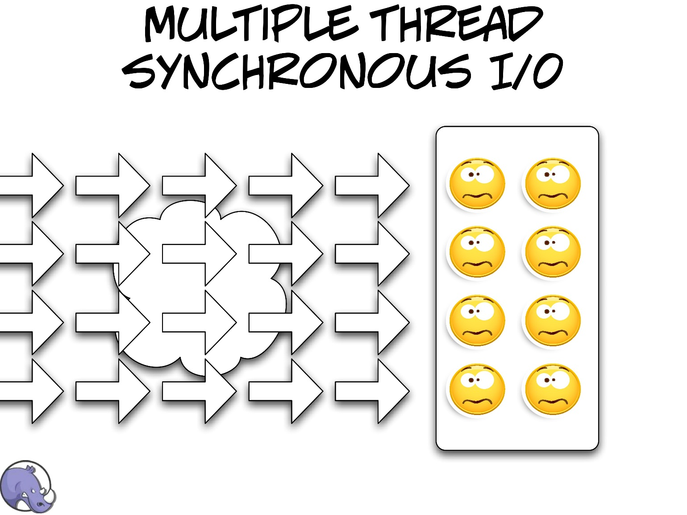

Slide 16
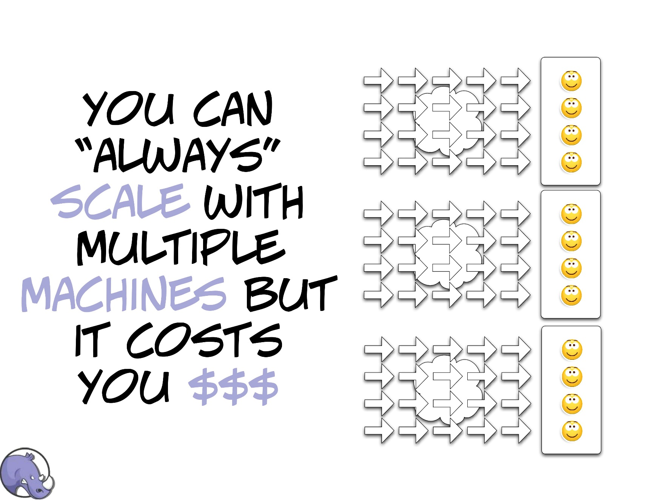

Slide 17


Slide 18
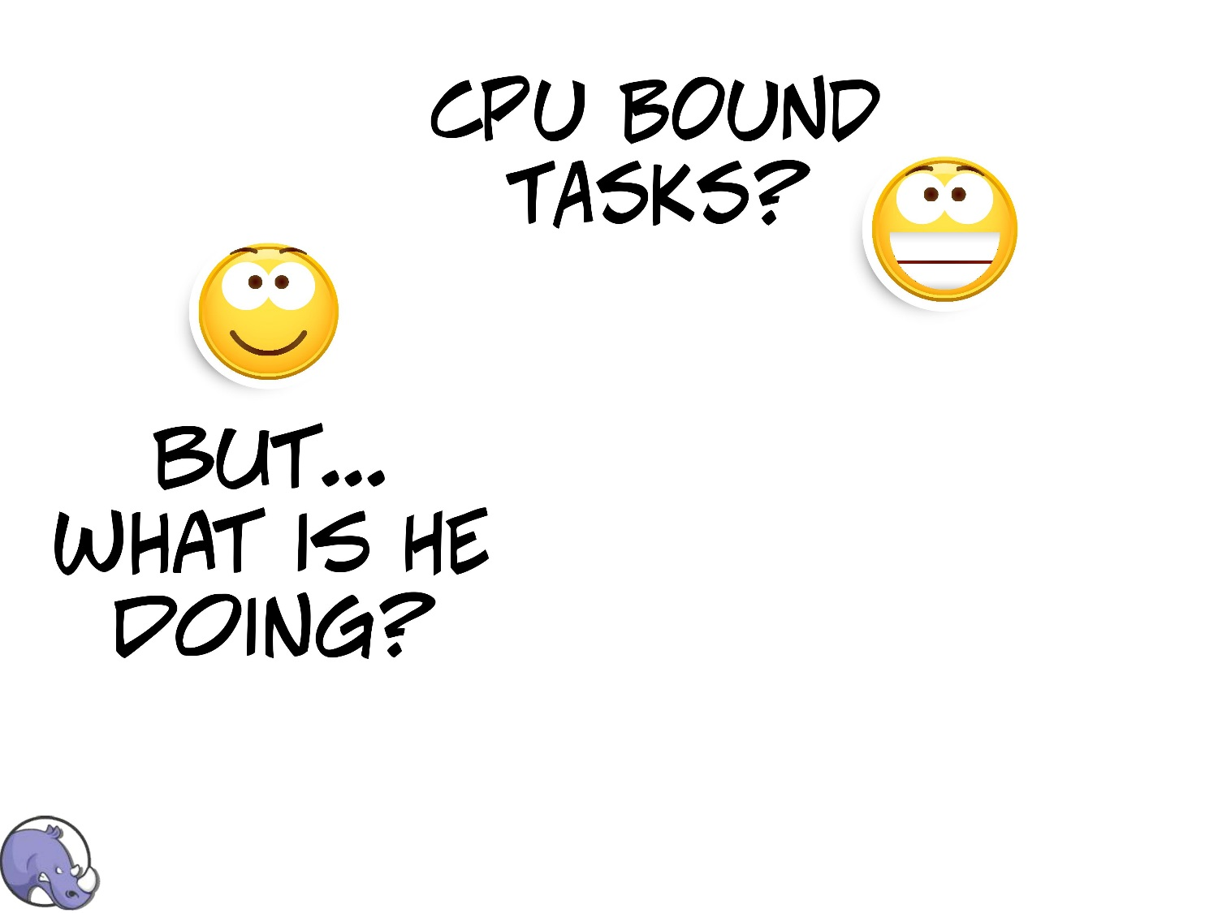

Slide 19
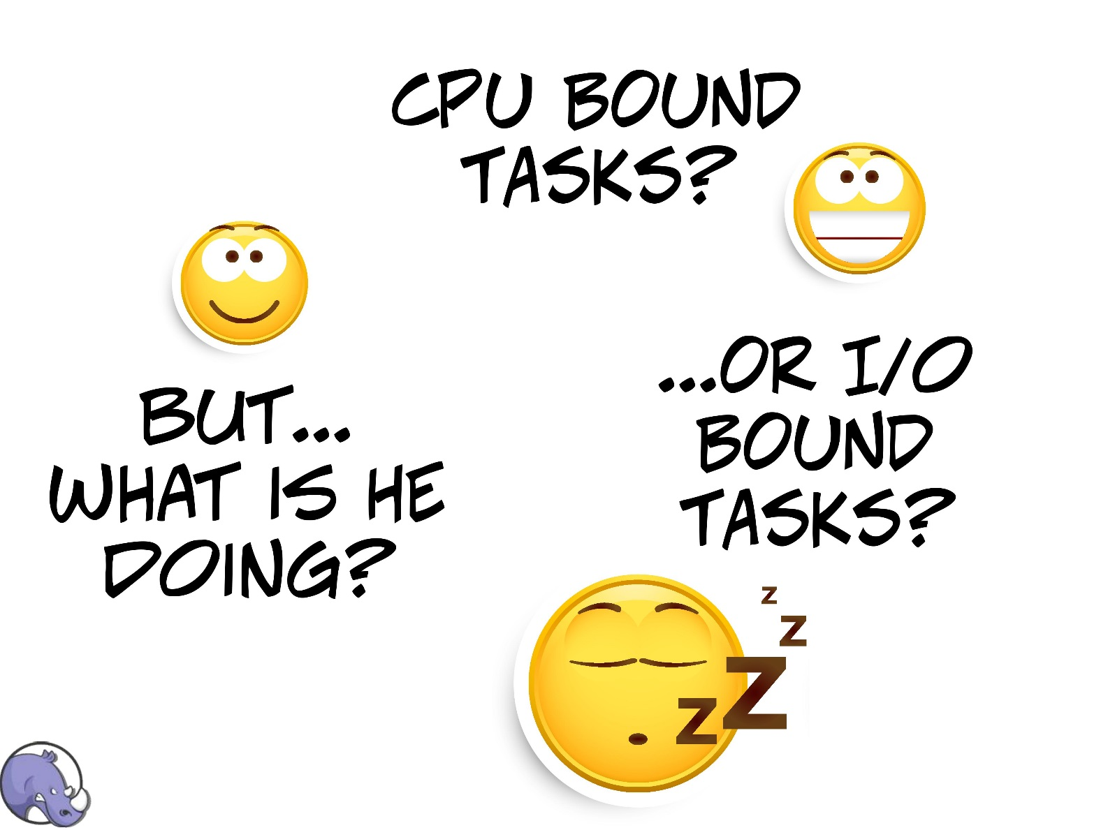

Slide 20
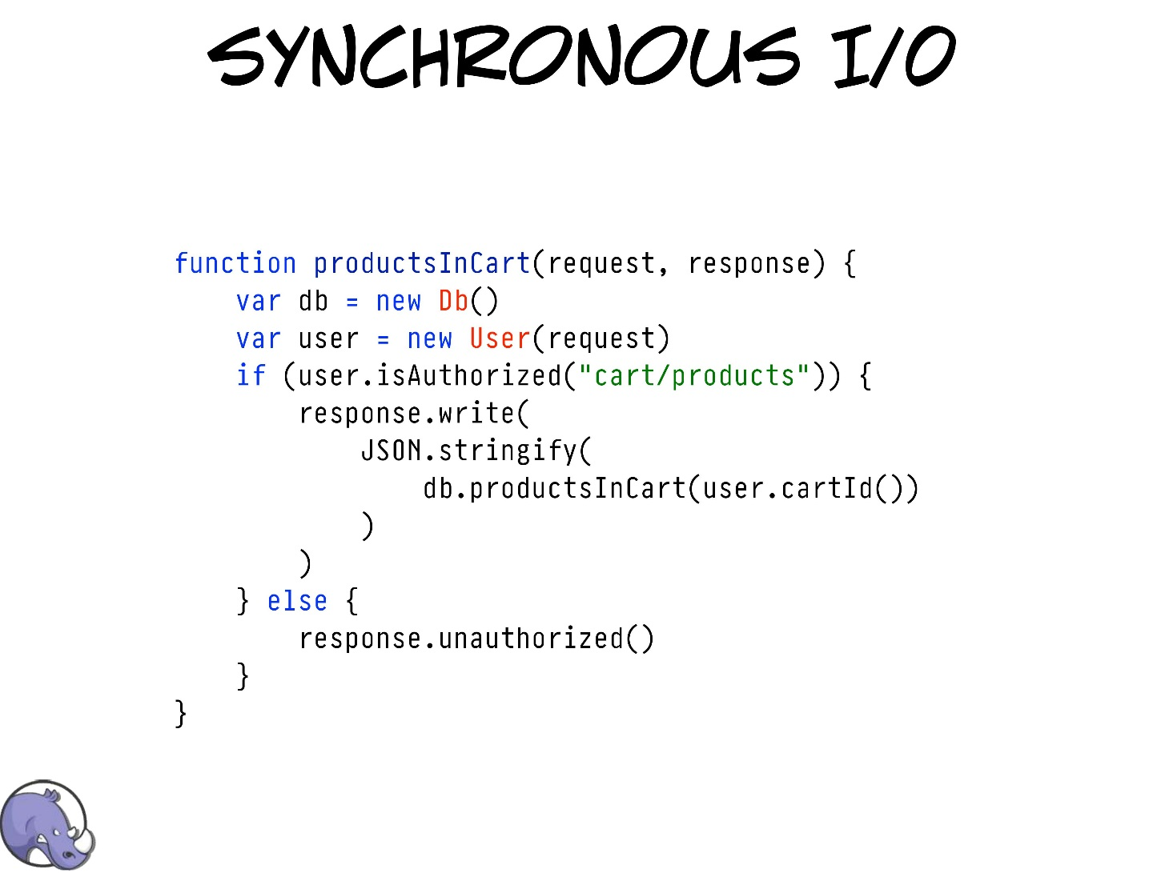

Slide 21
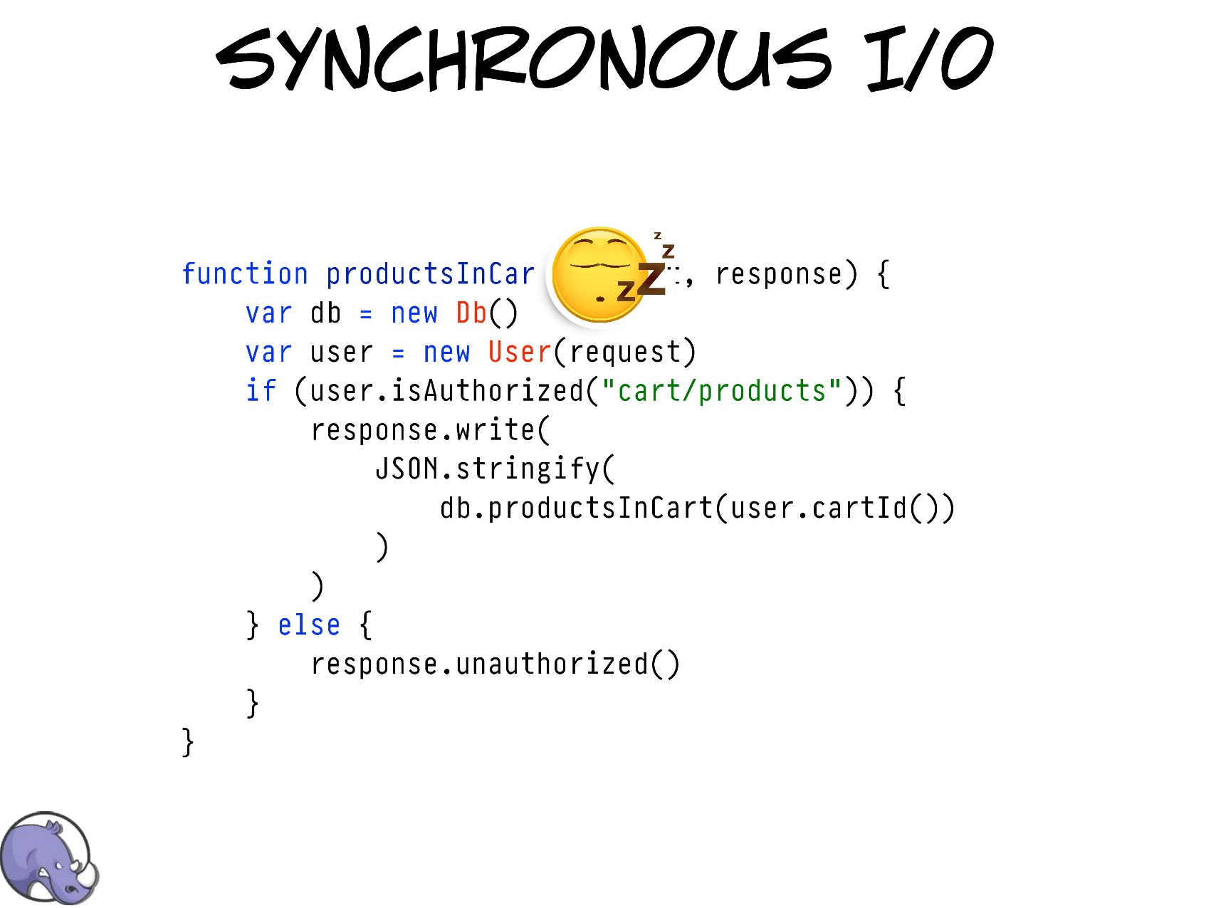

Slide 22
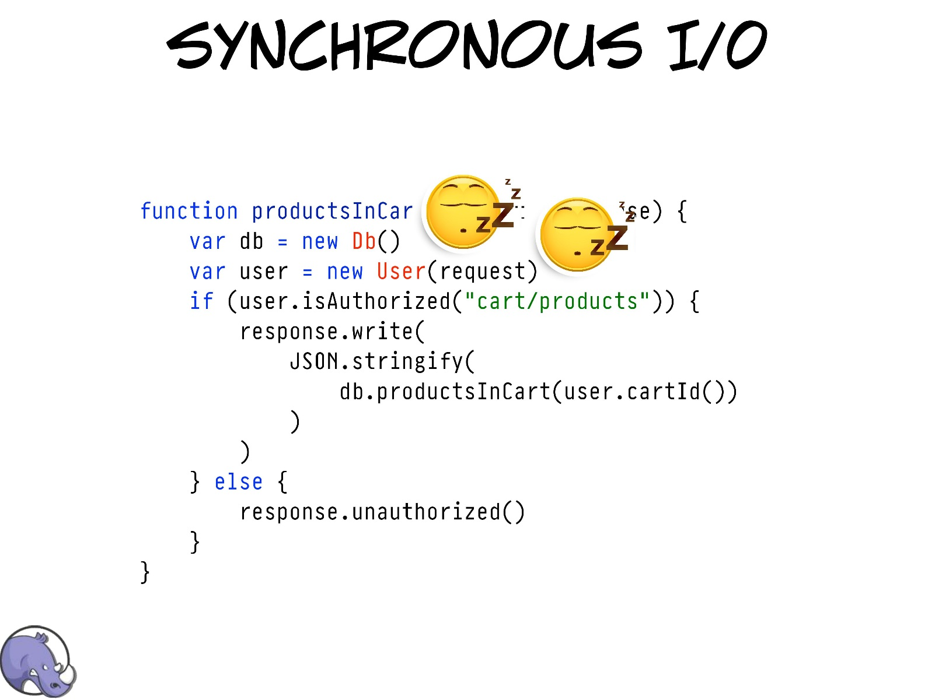

Slide 23
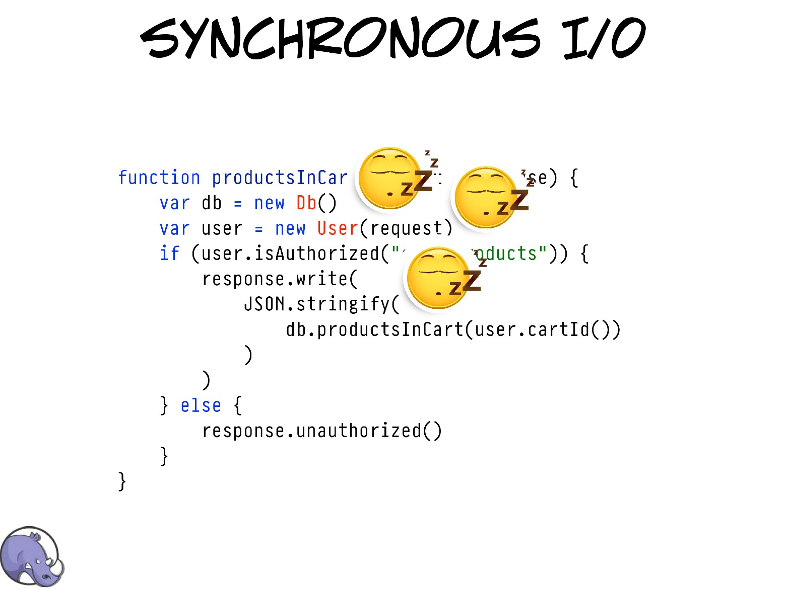

Slide 24
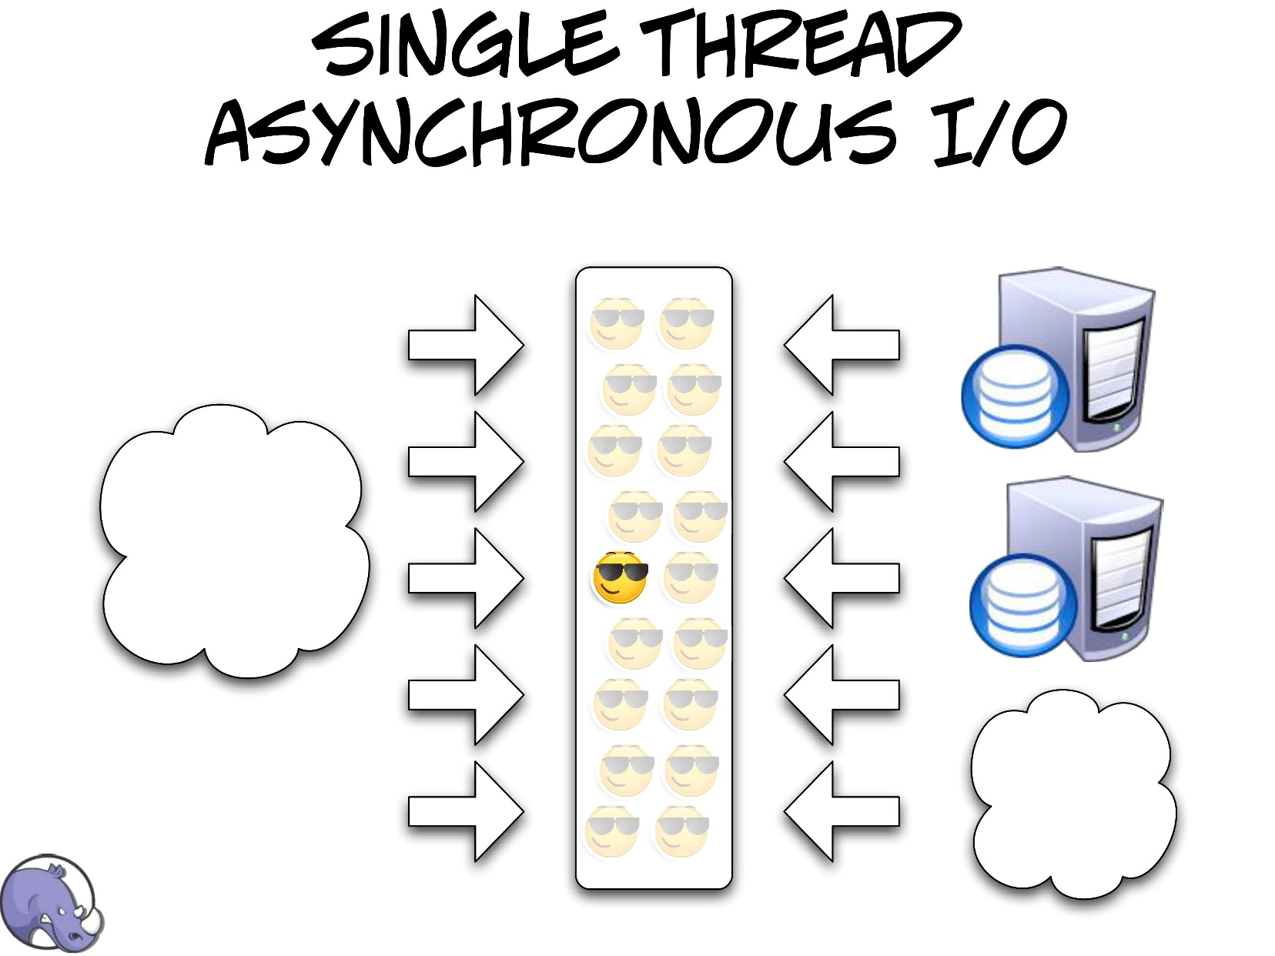

Slide 25
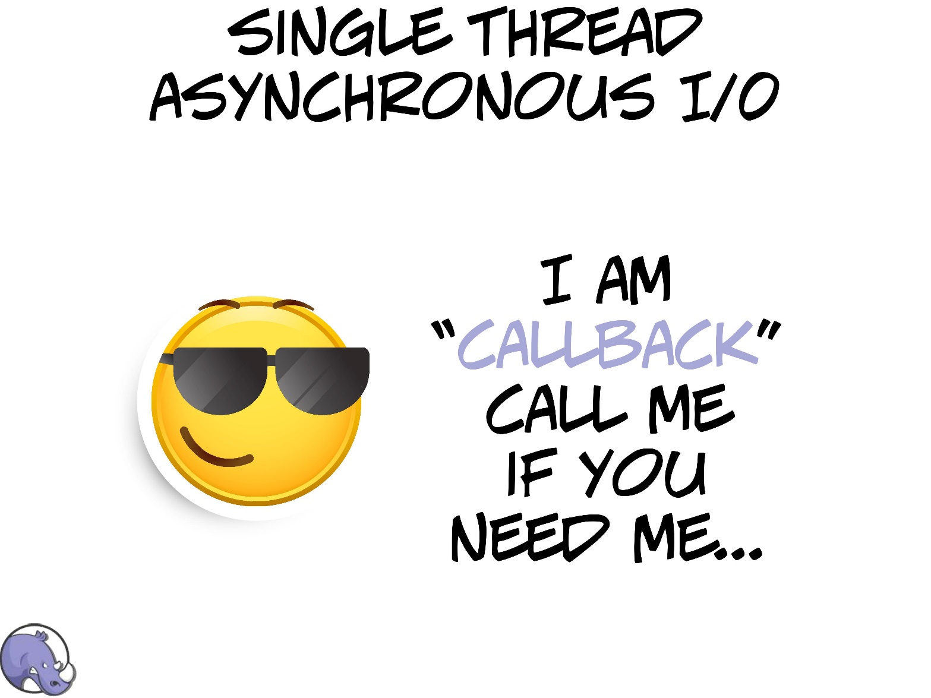

Slide 26
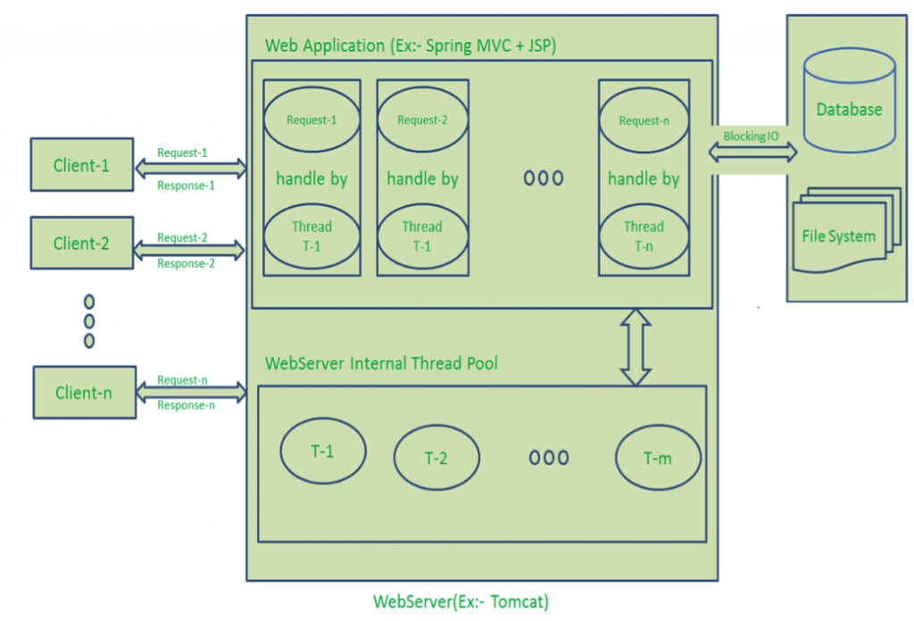

Slide 27
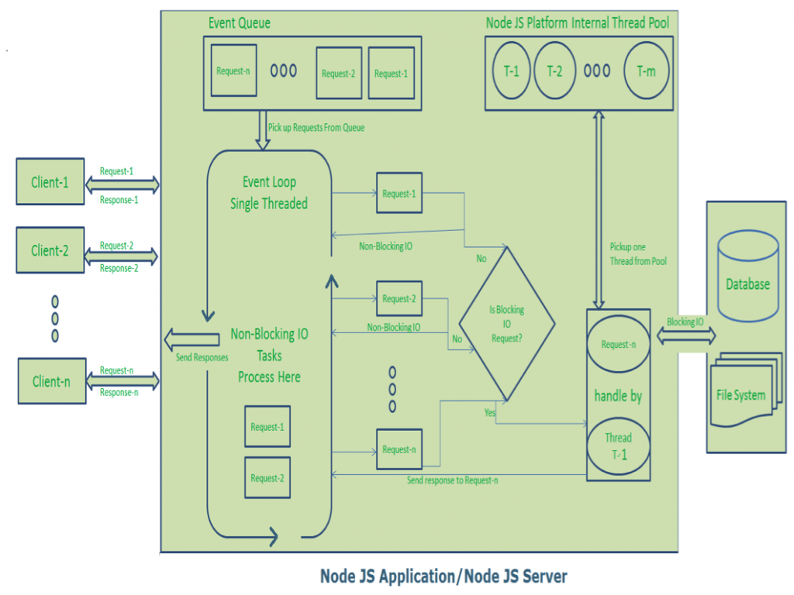

Slide 28
public class EventLoop {
while(true)
{
if(Event Queue receives a JavaScript Function Call){
ClientRequest request = EventQueue.getClientRequest();
If(request requires BlokingIO or takes more computation time) Assign request to Thread T1 Else Process and Prepare response } } }

Slide 29
Some Theory: Non-Blocking I/O
Traditional I/O
var result = db.query(“select x from table_Y”);
doSomethingWith(result); //wait for result!
doSomethingWithOutResult(); //execution is blocked!
Non-traditional, Non-blocking I/O
db.query(“select x from table_Y”,function (result){
doSomethingWith(result); //wait for result!
});
doSomethingWithOutResult(); //executes without any delay!

Slide 30
Example(HTTP Server & TCP Server)
Following code creates an HTTP Server and prints ‘Hello World’ on the browser:
var http = require('http');
http.createServer(function (req, res) {
res.writeHead(200, {'Content-Type': 'text/plain'});
res.end('Hello World\n'); }).listen(5000, "127.0.0.1");
Here is an example of a simple TCP server which listens on port 6000 and echoes whatever you send it:
var net = require('net');
net.createServer(function (socket) {
socket.write("Echo server\r\n");
socket.pipe(socket); }).listen(6000, "127.0.0.1");

Slide 31
Node.js Ecosystem
Node.js heavily relies on modules, in previous examples require keyword loaded the http & net modules.
Creating a module is easy, just put your JavaScript code in a separate js file and include it in your code by using keyword require, like:
var modulex = require(‘./modulex’);
Libraries in Node.js are called packages and they can be installed by typing
npm install “package_name”; //package should be available in npm registry @ nmpjs.org
NPM (Node Package Manager) comes bundled with Node.js installation.

Slide 32
Lets connect to a DB (MongoDB)
Install mongojs using npm, a mongoDB driver for Node.js
npm install mongojs
Code to retrieve all the documents from a collection:
var db = require("mongojs")
.connect("localhost:27017/test", ['test']);
db.test.find({}, function(err, posts) {
if( err || !posts) console.log("No posts found");
else posts.forEach( function(post) {
console.log(post);
});
});

Slide 33
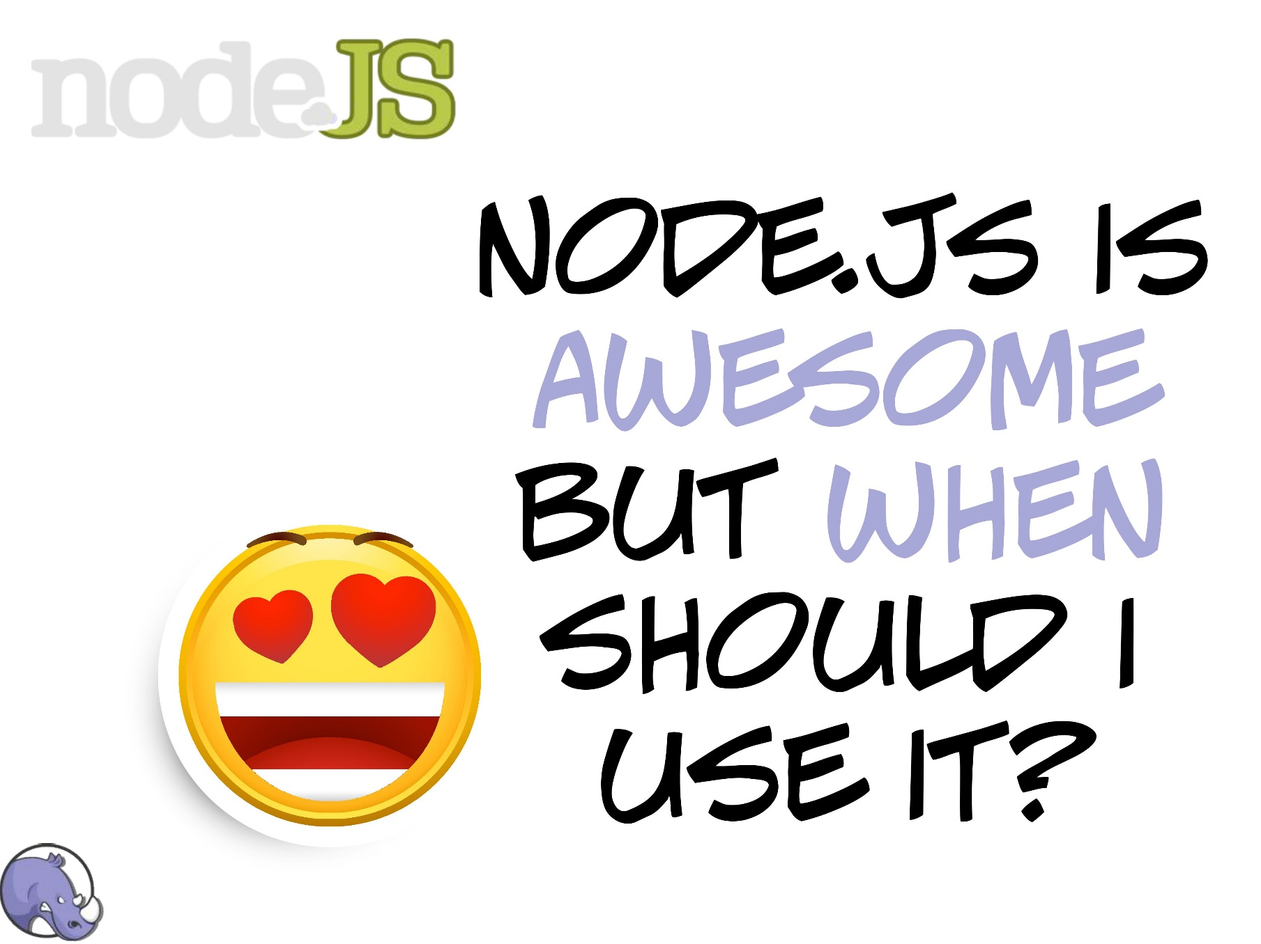

Slide 34
When to use Node.js?
Node.js is good for creating streaming based real-time services, web chat applications, static file servers etc.
If you need high level concurrency and not worried about CPU-cycles.
If you are great at writing JavaScript code because then you can use the same language at both the places: server-side and client-side.
More can be found at: http://stackoverflow.com/questions/5062614/how-to-decide-when-to-use-nodejs

Slide 35
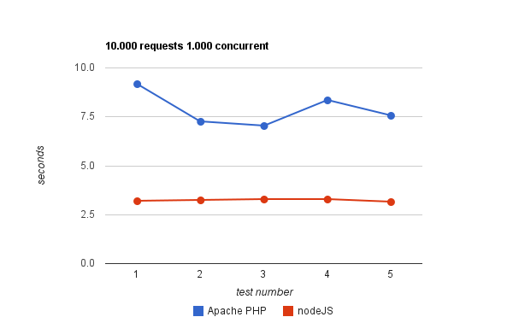
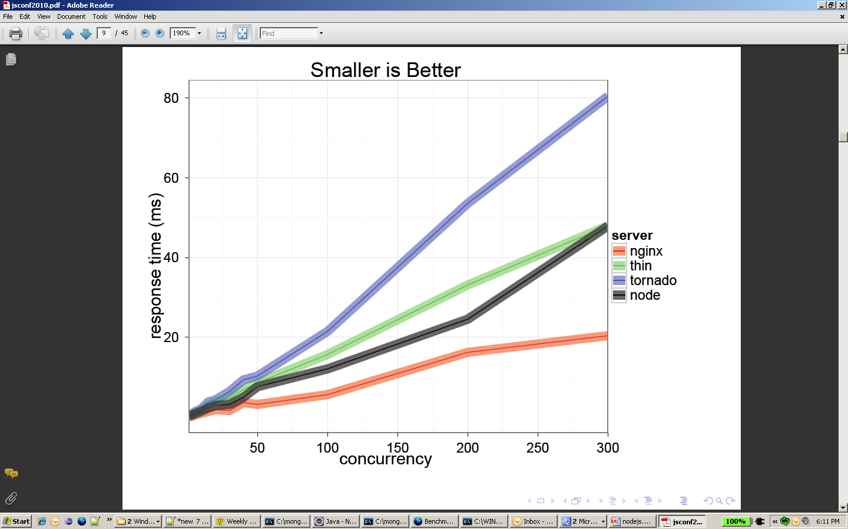
Some Node.js benchmarks
Taken from: http://code.google.com/p/node-js-vs-apache-php-benchmark/wiki/Tests
A benchmark between Apache+PHP and node.js, shows the response time for 1000 concurrent connections making 10,000 requests each, for 5 tests.
Taken from: http://nodejs.org/jsconf2010.pdf
The benchmark shows the response time in milli-secs for 4 evented servers.

Slide 36
Some examples of applications that you can create with Node.js are
Real-time multiplayer games
Web-based chat clients
Mashups that combine data sources from around the web
Single-page browser applications
JSON-based APIs

Slide 37
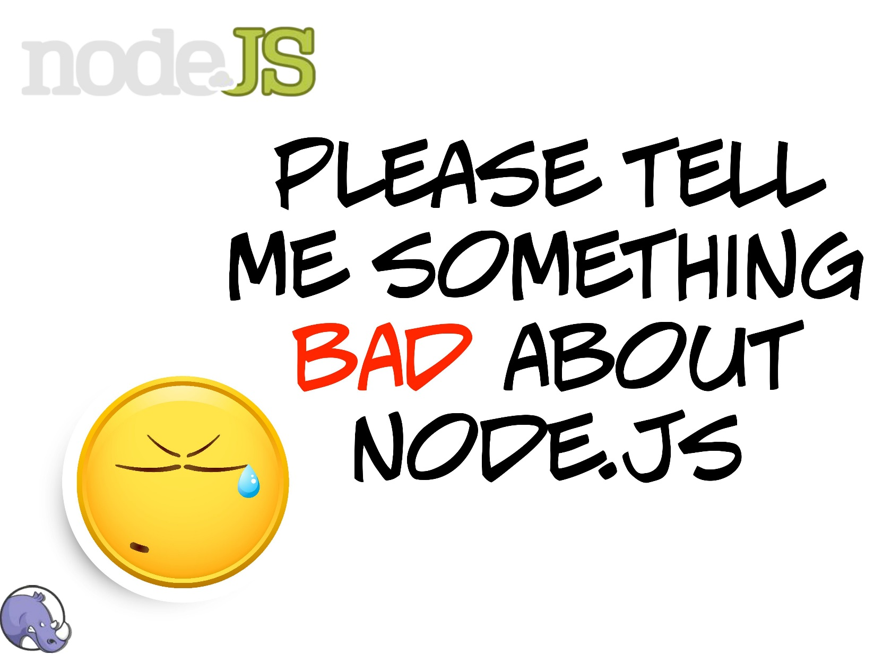

Slide 38
When to not use Node.js
When you are doing heavy and CPU intensive calculations on server side, because event-loops are CPU hungry.
Node.js API keeps on changing a lot from one revision to another and there is a very little backward compatibility. Most of the packages are also unstable. Therefore is not yet production ready.
Node.js is a no match for enterprise level application frameworks like Spring(java), Django(python), Symphony(php) etc. Applications written on such platforms are meant to be highly user interactive and involve complex business logic.

Slide 39
Who is using Node.js in production?
Yahoo! : iPad App Livestand uses Yahoo! Manhattan framework which is based on Node.js.
LinkedIn : LinkedIn uses a combination of Node.js and MongoDB for its mobile platform. iOS and Android apps are based on it.
eBay : Uses Node.js along with ql.io to help application developers in improving eBay’s end user experience.
Dow Jones : The WSJ Social front-end is written completely in Node.js, using Express.js, and many other modules.
Complete list can be found at:
https://github.com/joyent/node/wiki/Projects,-Applications,-and-Companies-Using-Node

Slide 40
Core Module

Slide 41
